Slide 1


Slide 2

GPU Accelerated Computing
Parallel Data Processing

Slide 3
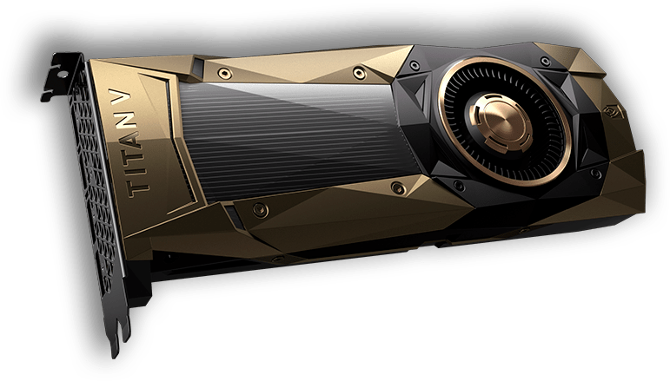
Largest GPU today...
Cores: 5120

Slide 4
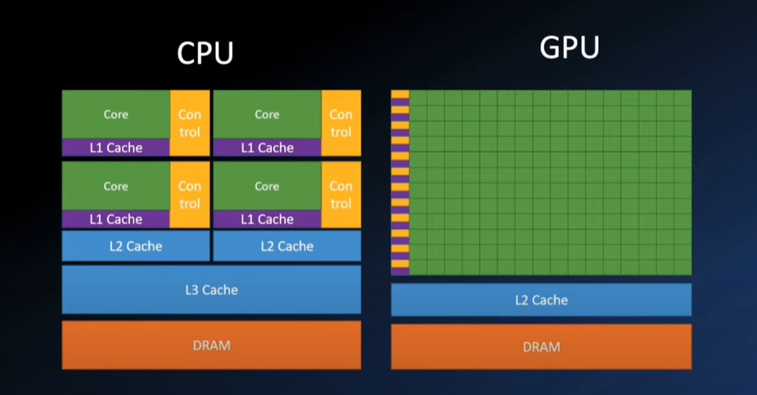

Slide 5
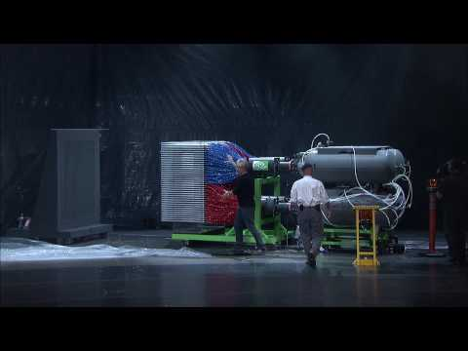
The power of GPU in Parallel computing

Slide 6
Tools and Ecosystem
https://developer.nvidia.com/tools-ecosystem
https://developer.nvidia.com/rapids

Slide 7
NVIDIA’s CUDA Python provides a driver and runtime API for existing toolkits and libraries to simplify GPU-based accelerated processing.
Python is one of the most popular programming languages for science, engineering, data analytics, and deep learning applications. However, as an interpreted language, it’s been considered too slow for high-performance computing.

Slide 8

Numba makes Python code fast
https://numba.pydata.org/

Slide 9

Set up CUDA Python
To run CUDA Python, you’ll need the CUDA Toolkit installed on a system with CUDA-capable GPUs.
https://developer.nvidia.com/cuda-downloads
OR
We can access one of the thousands of GPUs available from cloud service providers, including Amazon AWS, Google Cloud, Microsoft Azure, and IBM SoftLayer etc.

Slide 10

Drop in replacement
NumPy/SciPy-compatible Array Library for GPU-accelerated Computing with Python

Slide 11
Applications
https://www.nvidia.com/en-us/gpu-accelerated-applications/
https://www.pny.com/file%20library/commercial/resource%20center/rtx%20workstations/gpu-applications-catalog.pdf

Slide 12
Reference of the material:
https://developer.nvidia.com/cuda-toolkit
https://cupy.dev/
https://numpy.org/
https://scipy.org/
https://www.youtube.com/
https://numba.pydata.org/
https://www.preferred.jp/en/news/pr20221111-3/

Slide 13
Thank you, Questions?

